Slide 1
Projection Warping on Non-Flat Surfaces [PWNS]
Karlo Luis Martinez Martos

Slide 2
Outline
Introduction
Basic concepts
Research Question
Methods
Warping and Blending
Hardware Configuration
Tools and development
Results
Problem solved?
How far did we get?
What are the areas have not been researched?
Questions
Notes:
Methods
Warping and Blending
Calibration
Distortion
Hardware Configuration
Prototyping

Slide 3
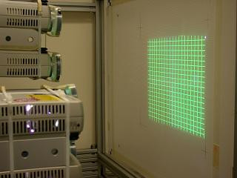
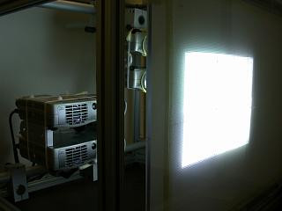
Introduction
Projecting images is not hard.
Make that harder for us but better for you, the viewer?
Notes:
Projecting images is not a hard thing to accomplish, but it is certainly annoying for most of us when it just does not look right.
What if I tell you that our goal is to make that harder for us but better for you, the viewer?
We already found a way to get the first part working, but what else is there?

Slide 4
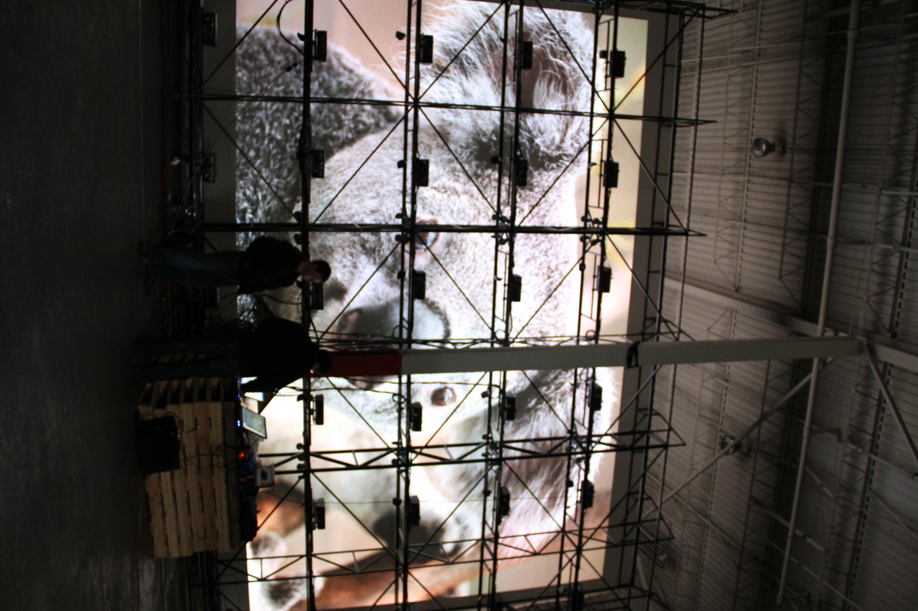
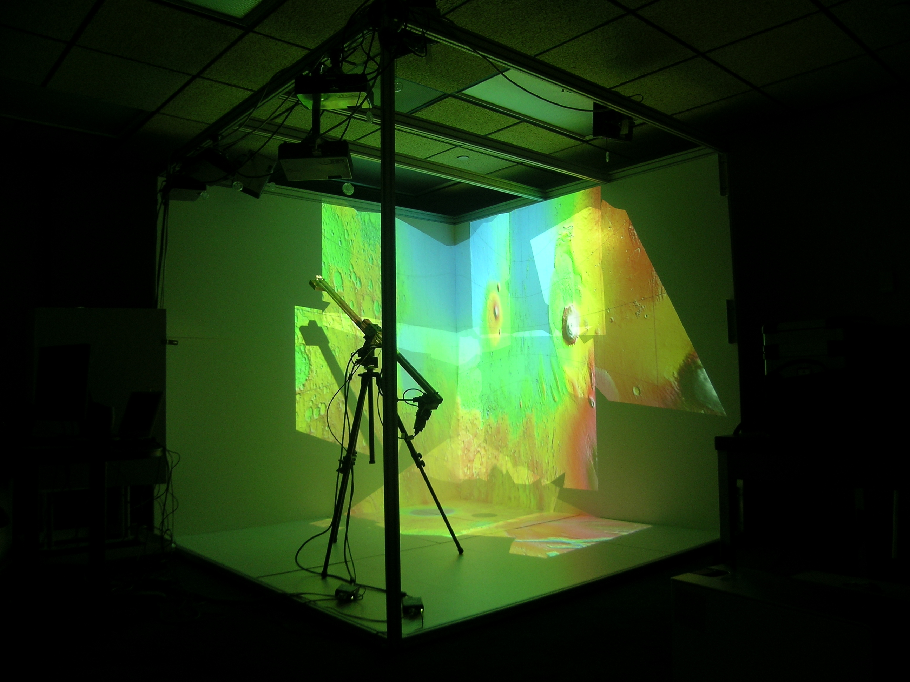
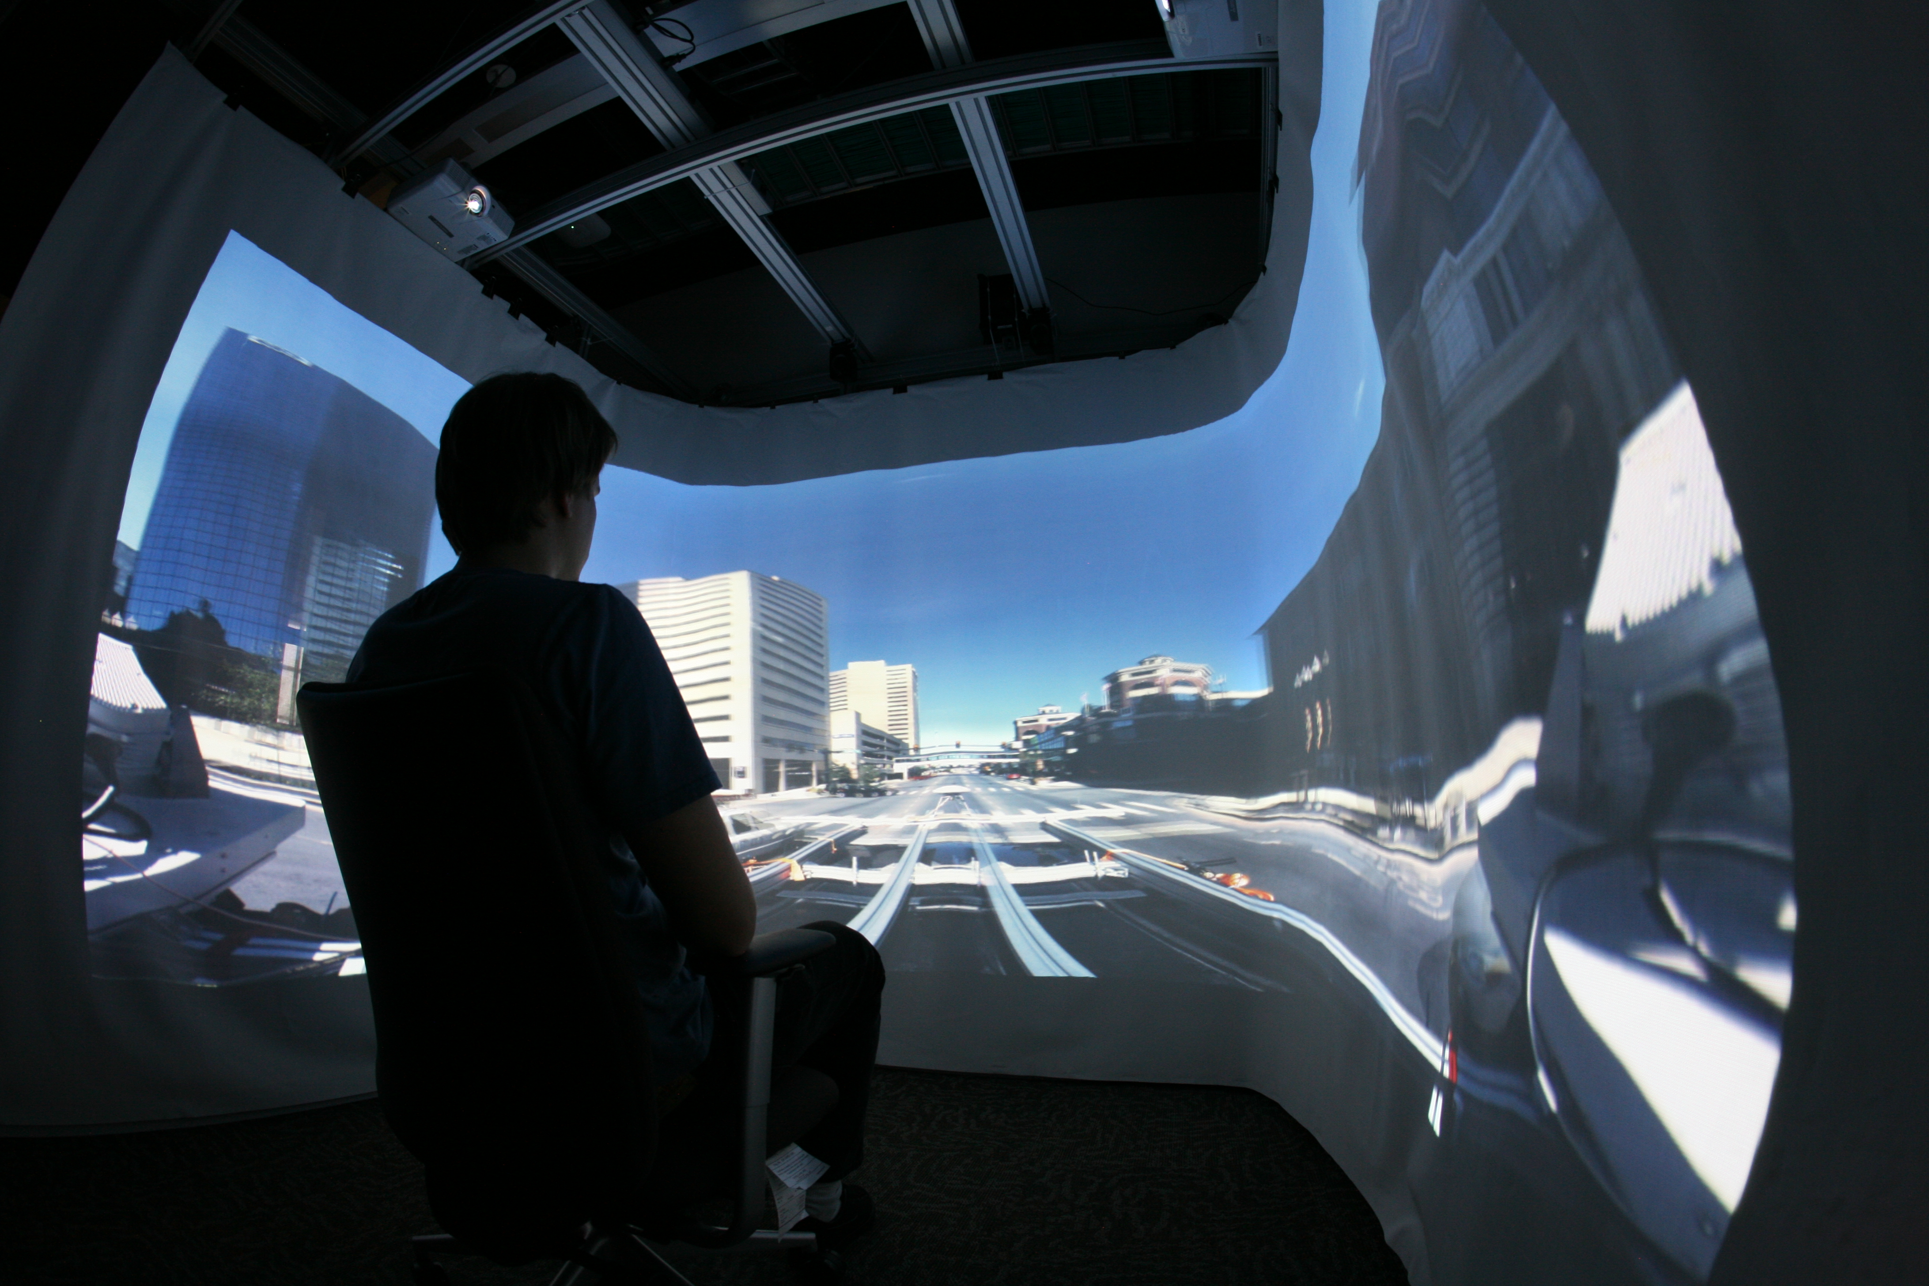
Introduction
Back projection display
Immersive environment
Notes:
We started by putting two projection together.
WOW! That’s great.
Then we started putting those projectors in awkward places to project something new.
Later we integrated other technologies to the mix and we keep on doing that
EPIC LVL OF DIFFICULTY ON MODERN INOVATION
We naturally tend to display inwards onto surface on our surrounding Object wrapping inverts that vision.

Slide 5
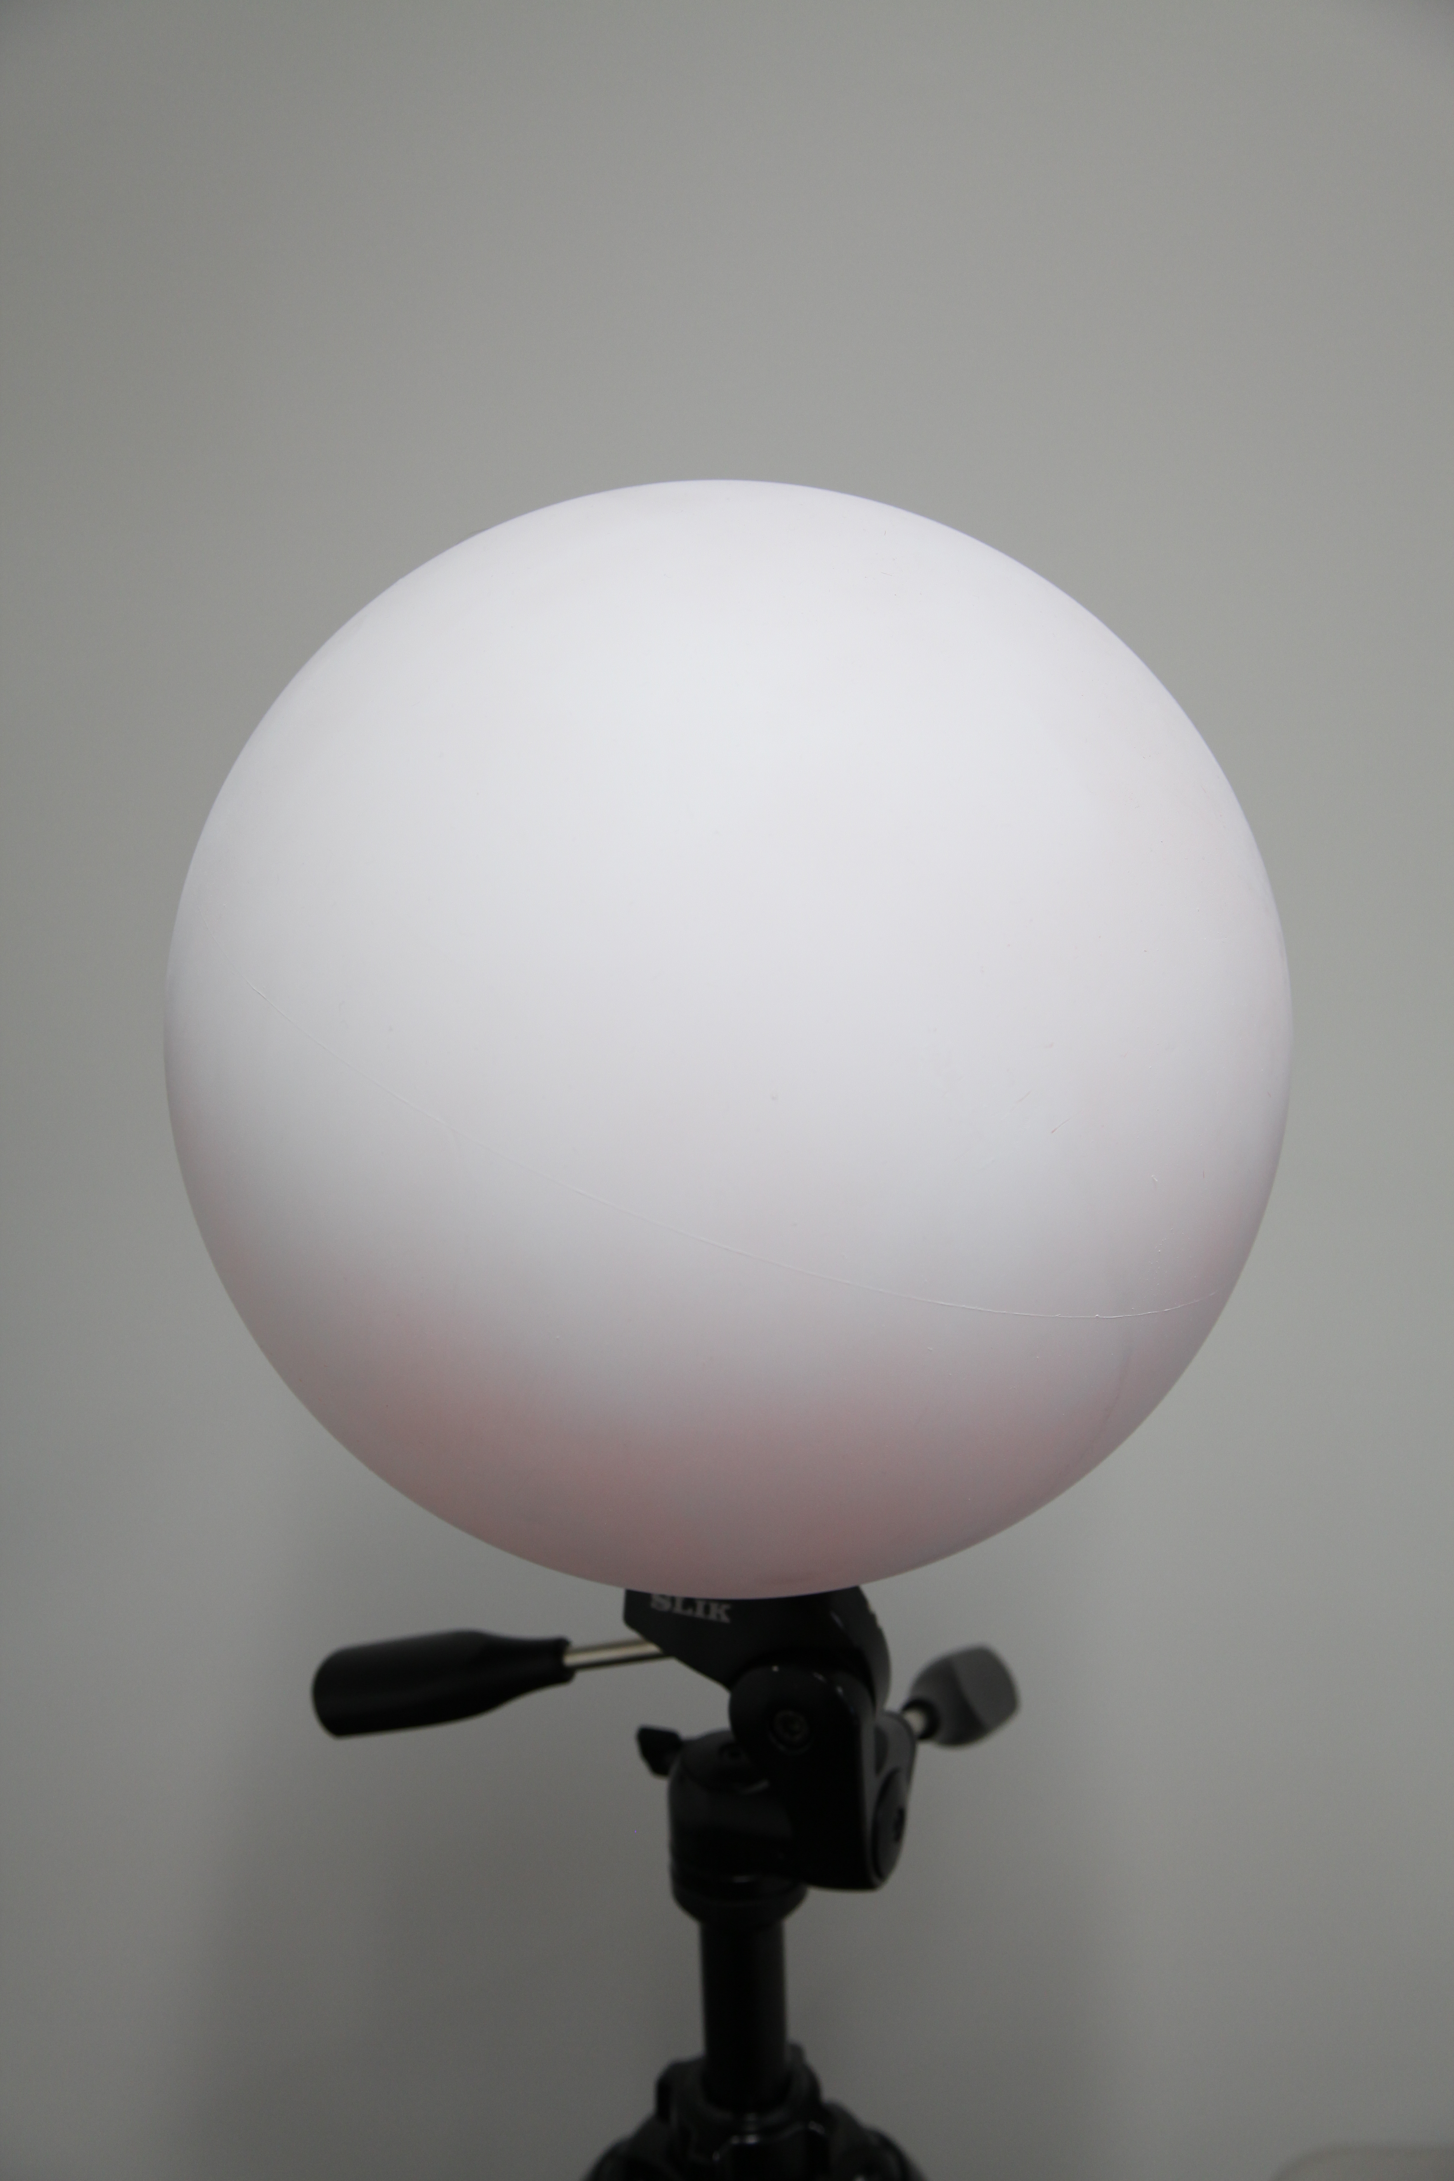
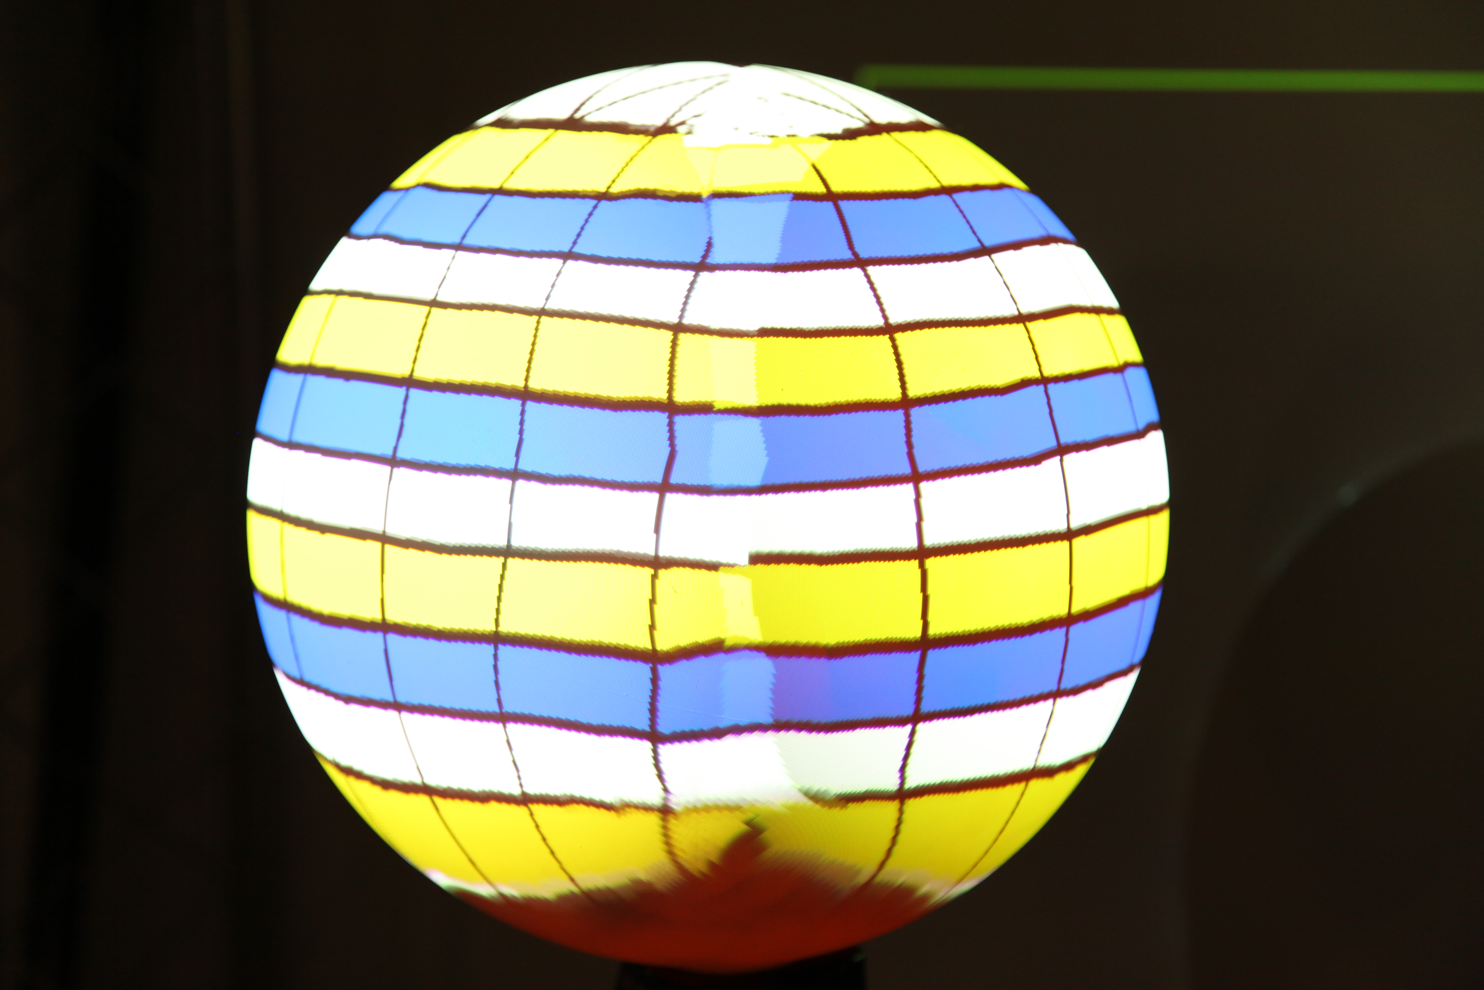
Introduction
3D or non-flat (curved and smooth) objects as display surfaces and doing it right.
Notes:
Our efforts are directed to 3D or non-flat (curved and smooth) objects as display surfaces and doing it right. Giving our image the correct texture, shape, contour, depth and focus depending on the object and using multiple displays around it.

Slide 6
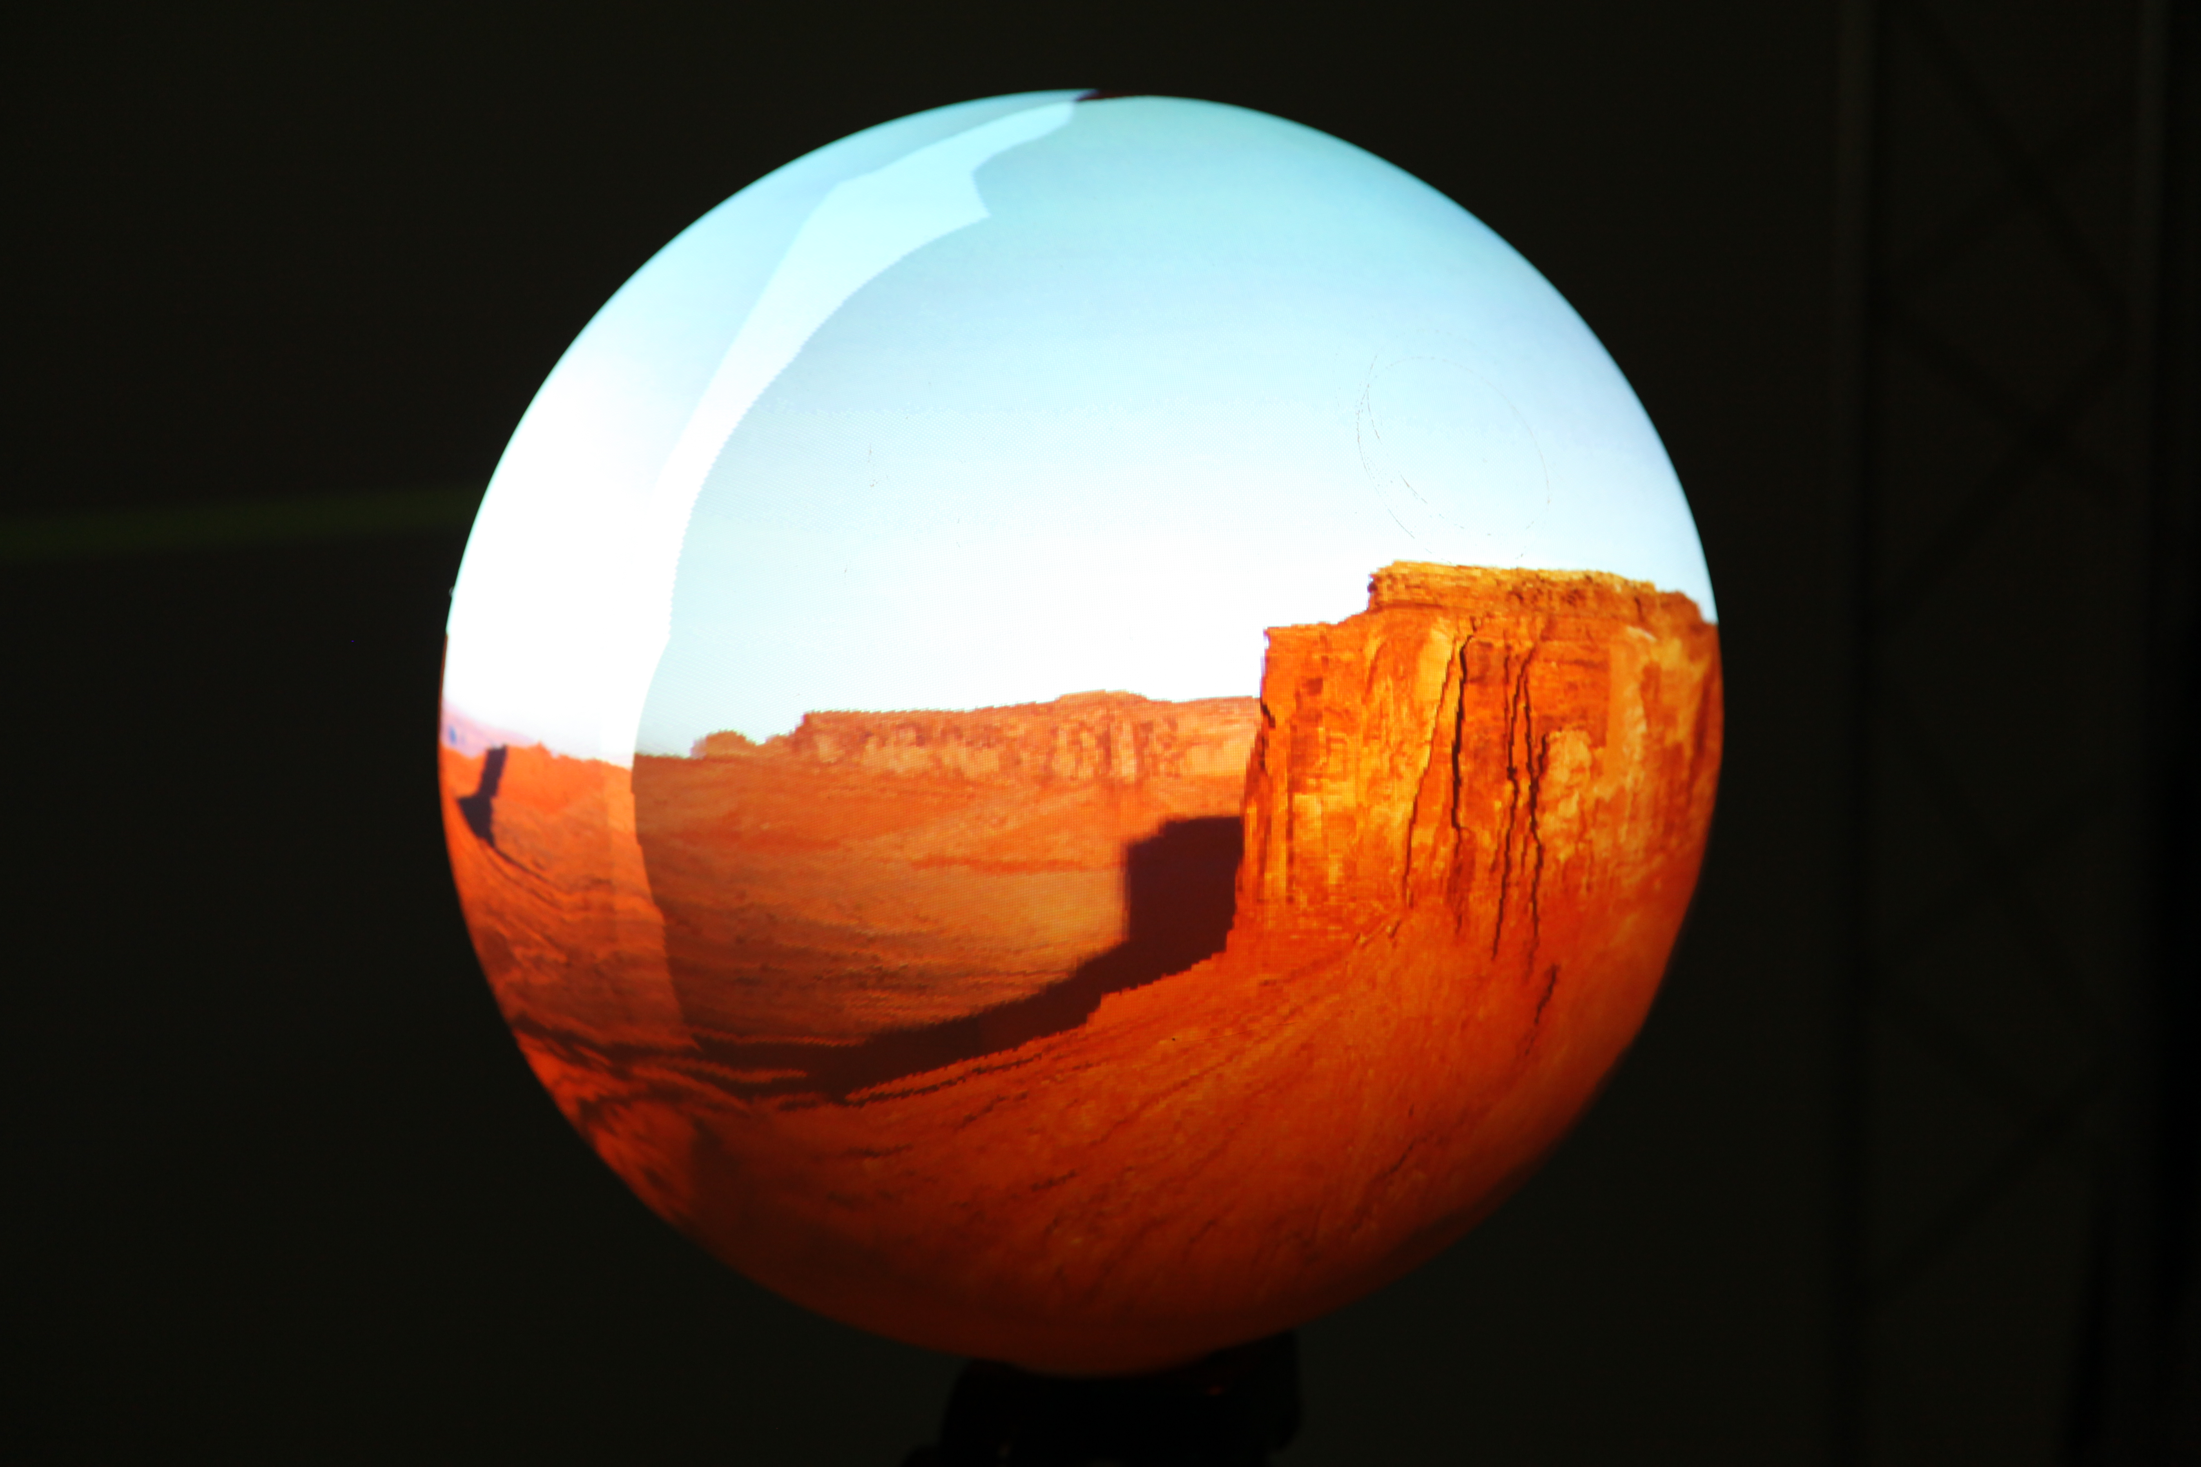

Slide 7
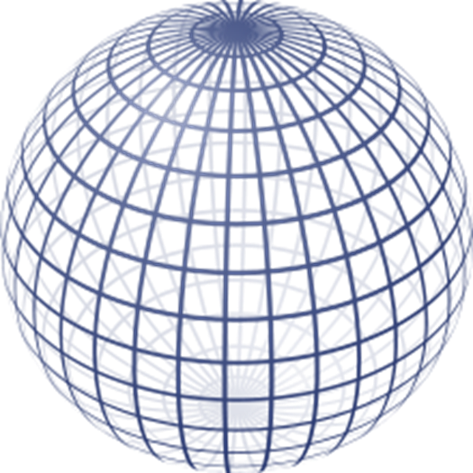
Research Question:
Can we distort an image so it looks smooth and crisp on the surface of a non-flat object?

Slide 8
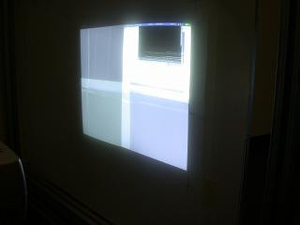
Method
Warping
Uniform image
Blending
Uniform brightness
Hardware Configuration
Still on early stages
Notes:
Warping
Matching single and consecutive projections by manipulating distortions for the image to "wrap" into a perimeter
The effect of light, color displacement, focus on the object
Blending
Circular outward shapes have different and unconventional blending techniques, for multiple display overlaps
Immersive caves or capsules have their inwards bend
Hardware Configuration
Still on early stages
Previously used low throw ratio projectors on a 8" textured
Conventional projectors on a 20” beach ball

Slide 9
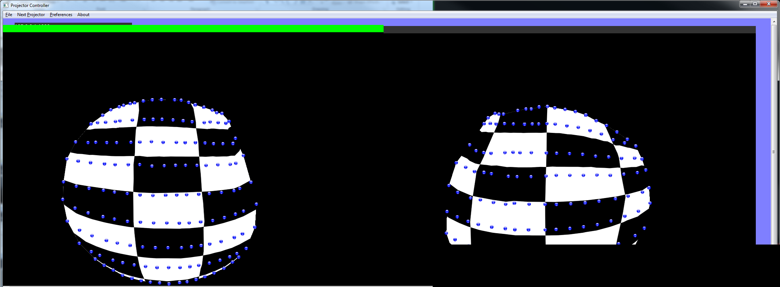
Tools and Development
Application for image calibration
OpenGL
C/C++ language
Windows API
Notes:
Previously created application for image calibration for warping and blending that works like a borrowed pen.
We don’t want to break it, but works like any other.
Construction a structure to set-up our project and make it functional and efficient.
Design
Hardware compatibility
Scalability
Size is not troublesome
Aesthetics
Prototyping

Slide 10
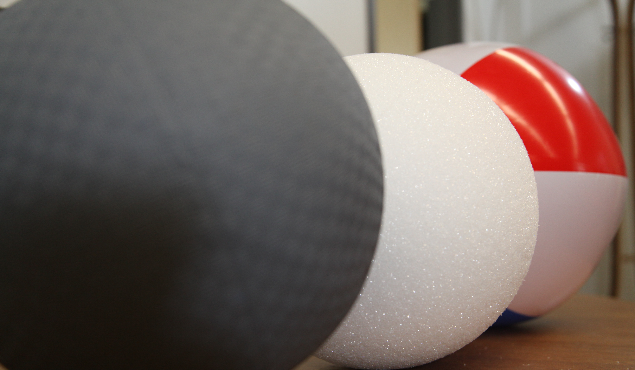
Tools and Development
“THE” Structure
Design
Ball Size
Structure size
Projector throw ratio
Scalability
Aesthetics
Notes:
Previously created application for image calibration for warping and blending that works like a borrowed pen.
We don’t want to break it, but works like any other.
Construction a structure to set-up our project and make it functional and efficient.
Design
Hardware compatibility
Scalability
Size is not troublesome
Aesthetics
Prototyping

Slide 11
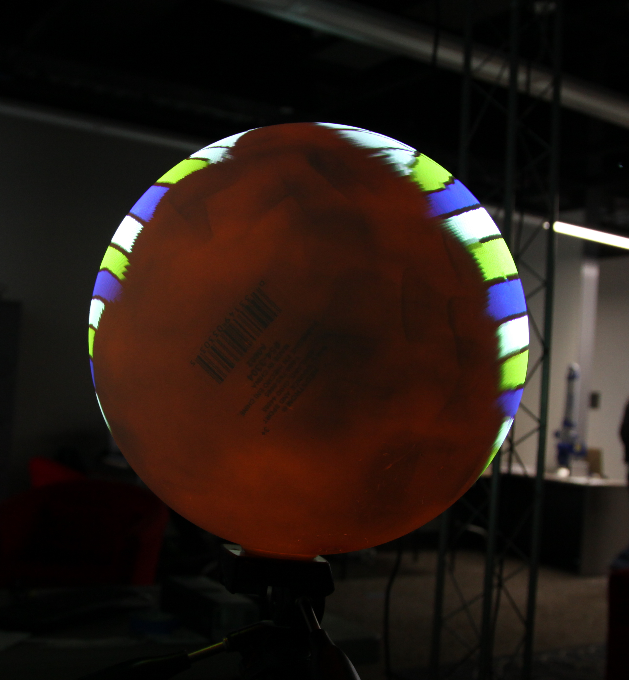
Results
Permanent Set-up
Multiple (two) projector display
70%+ cover area (no kidding)
Detailed manual calibration
Future
Better calibration methods
Final product
Application development
Customized interface
Interactive
Notes:
Future
Interactive development
Application development

Slide 12
Questions?
BRING IT!
Thank you VIS CENTER & Google for the awesome images!

